Slide 1







Web Programming PHP&MySQL
FSTM KUIS

Slide 2

T00 PHP + LARAGON
w
bit.ly/fstmtube

Slide 3




3-tier
Tier3 : Database
Tier1 : Client/browser
Tier2 : Middleware (Webserver + PHP)

Slide 4


T1: CLIENT (BROWSER HTML)
The User-interface

Slide 5

T2: Web server + PHP interpreter
Hold logic/ business process
Server-side scripting
Dynamic web

Slide 6

T3: DATABASE
Place to hold database/records/data

Slide 7

LARAGON.ORG
Development stack
https://laragon.org/download.html
Apache/ Nginx / PHP/ MySQL / NodeJS / etc…

Slide 8
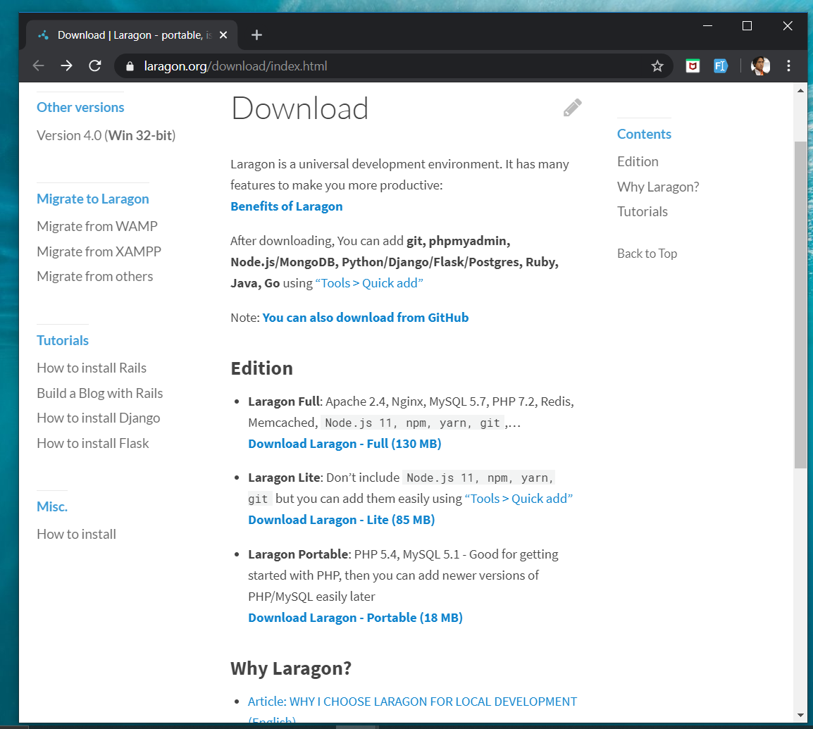
DOWNLOAD FROM LARAGON.org
Laragon.org

Slide 9
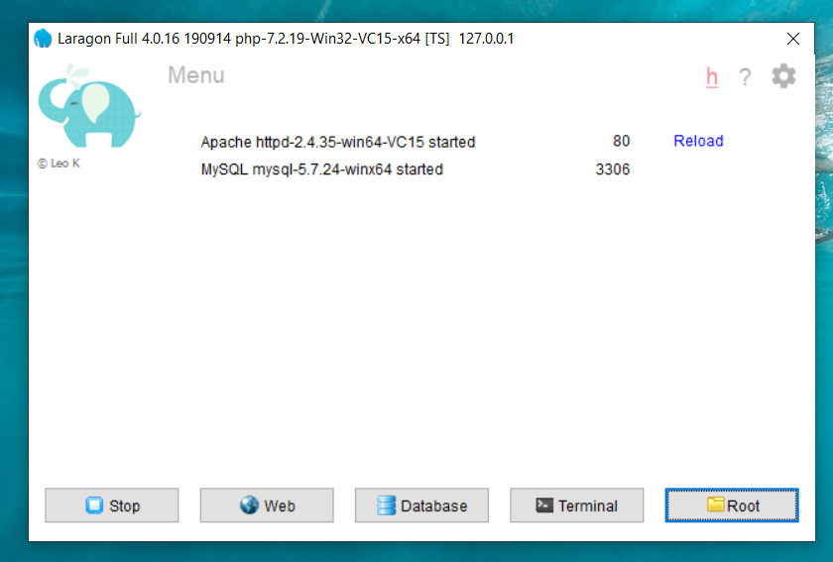
LARAGON INTERFACE
Start/stop servers
localhost
db client (HeidiSQL)
cli/npm/composer
go to webroot folder

Slide 10
T01 HTML5 & Bootstrap (Web Programming)
FSTM KUIS

Slide 11
T01 HTML5
w
bit.ly/fstmtube

Slide 12
Training outline
HTML5 – refers to the modern day of HTML which promotes native handling of video & audio & animation without having to install additional plugins to browser.
Bootstrap – A HTML framework supports responsive web design to provide one time webpage development for smartphone, tablet and desktop.

Slide 13
HTML5
HTML5 – refers to the modern day of HTML which promotes native handling of video & audio & animation without having to install additional plugins to browser.
<!DOCTYPE html>
Try: https://www.w3schools.com/html/tryit.asp?filename=tryhtml_headings

Slide 14
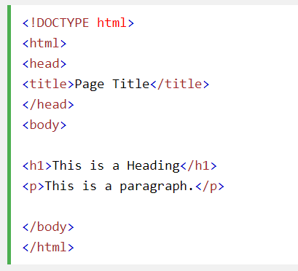
Typical HTML CODE

Slide 15
HTML5 image handling
<img src="pic_mountain.jpg" alt="Mountain View" style="width:304px;height:228px;">
Use width 100% to support responsive layout design.
Try: https://www.w3schools.com/html/tryit.asp?filename=tryhtml_images_trulli

Slide 16
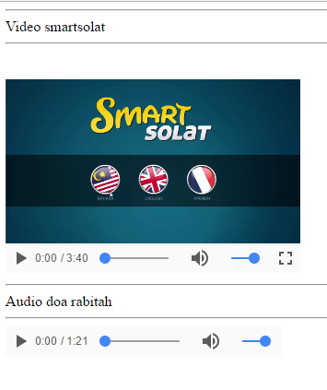
HTML5 Native video
<video width="320" height="240" controls> <source src="movie.mp4" type="video/mp4"> <source src="movie.ogg" type="video/ogg"> Your browser does not support the video tag. </video>
Try: https://www.w3schools.com/html/tryit.asp?filename=tryhtml5_video

Slide 17
HTML5 Native AUDIO
<audio controls> <source src="horse.ogg" type="audio/ogg"> <source src="horse.mp3" type="audio/mpeg"> Your browser does not support the audio element. </audio>

Slide 18
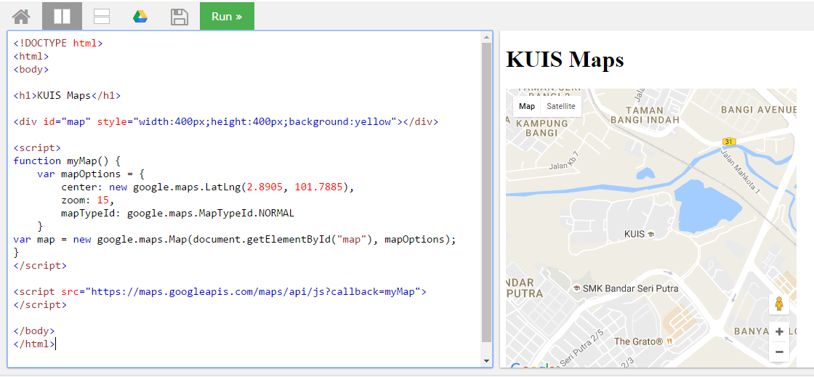
Location MAPS

Slide 19
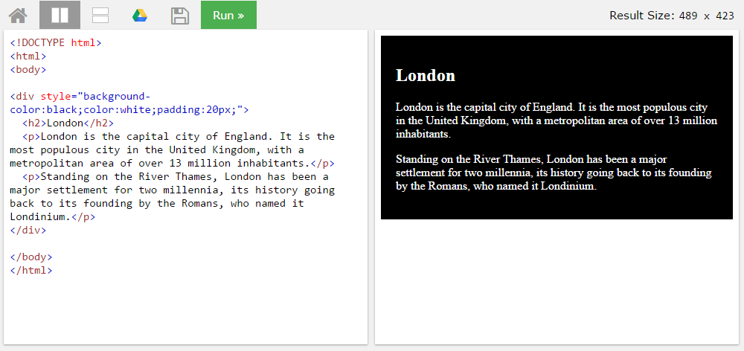
BLOCK <DIV>

Slide 20
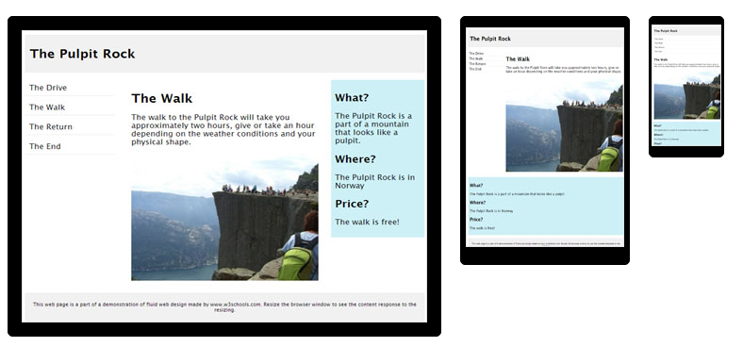
HTML Responsive layout

Slide 21
HTML Responsive layout
What is Responsive Web Design?
Responsive Web Design makes your web page look good on all devices (desktops, tablets, and phones).
Responsive Web Design is about using CSS and HTML to resize, hide, shrink, enlarge, or move the content to make it look good on any screen

Slide 22
VIEWPORT
<meta name="viewport" content="width=device-width, initial-scale=1">
The viewport varies with the device, and will be smaller on a mobile phone than on a computer screen.
The initial-scale=1.0 part sets the initial zoom level when the page is first loaded by the browser.

Slide 23
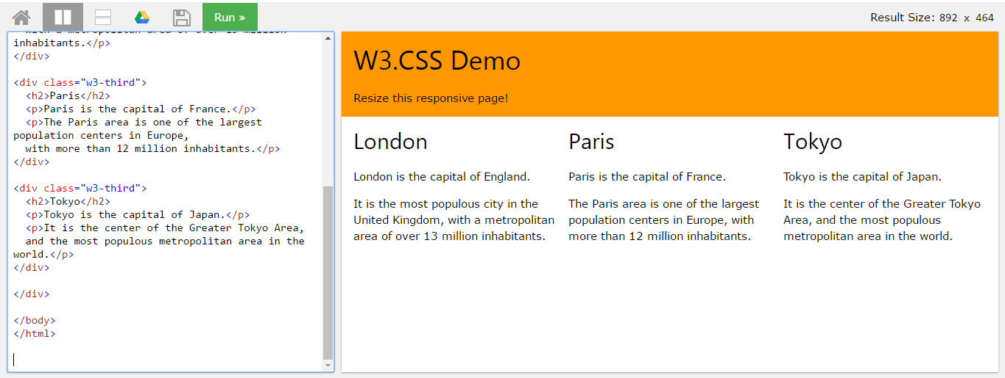
HTML Responsive layout

Slide 24
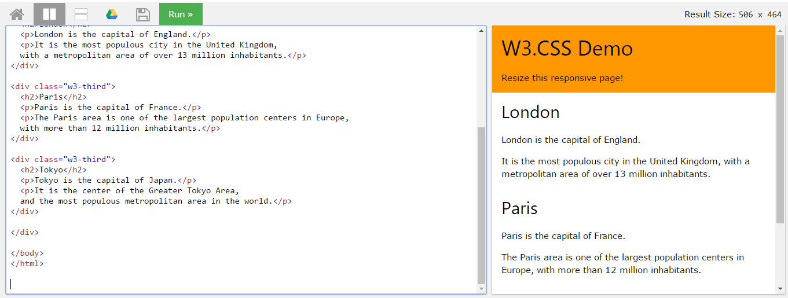
HTML Responsive layout

Slide 25
T02 Bootstrap + PHP Include
FSTM KUIS

Slide 26
T02 BOOTSTRAP + PHP include
w
bit.ly/fstmtube

Slide 27

Bootstrap
A HTML framework supports responsive web design to provide one time webpage development for smartphone, tablet and desktop.

Slide 28
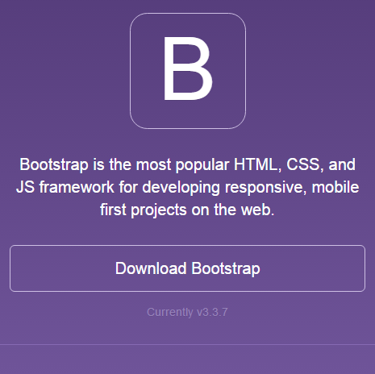
Bootstrap
Download framework from getbootstrap.com
OR use the CDN

Slide 29
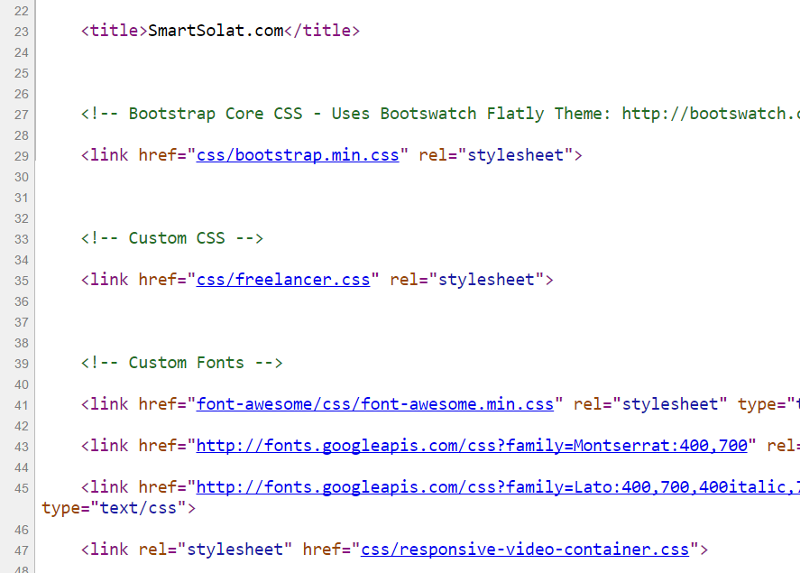
Bootstrap -setting
Copy the CSS script to the project folder.
> OR we can use CDN server

Slide 30
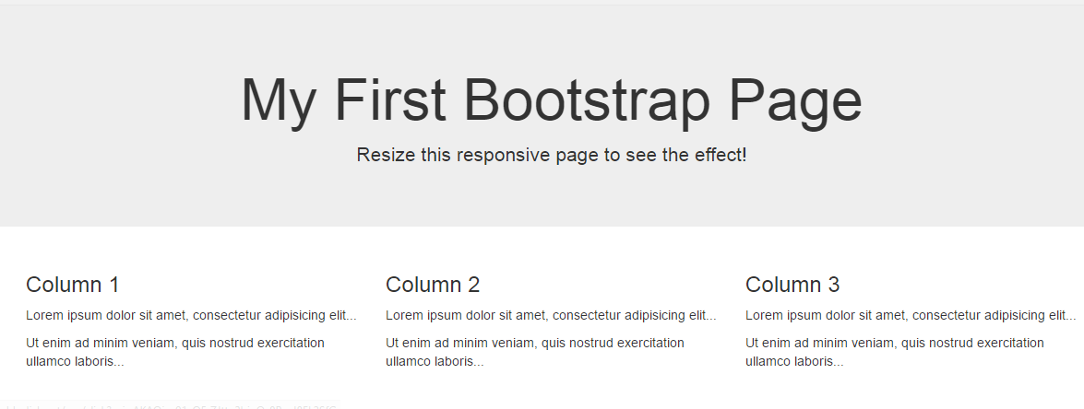
Basic bootstrap layout
Try it here http://www.w3schools.com/bootstrap/tryit.asp?filename=trybs_default&stacked=h

Slide 31
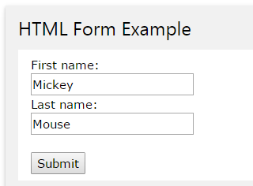
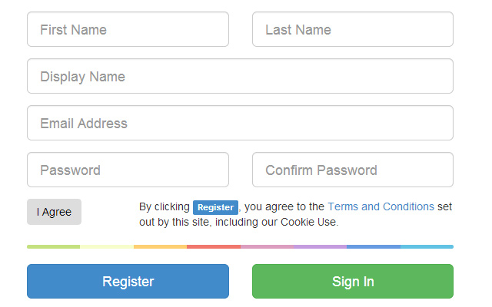
BOOTSTRAP FORM

Slide 32
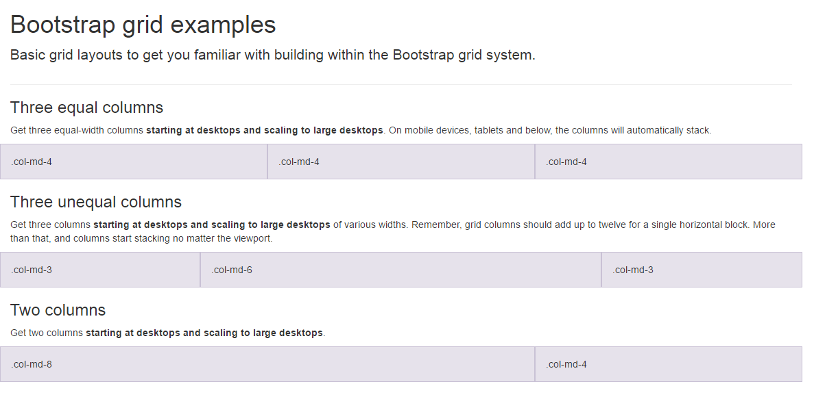
BootSTRAP GRID SYSTEM

Slide 33
BootSTRAP GRID SYSTEM DESKTOP
Banner
Main Content
Sidebar
Footer

Slide 34
BootSTRAP GRID SYSTEM MOBILE
Banner
Main Content
Sidebar
Footer

Slide 35
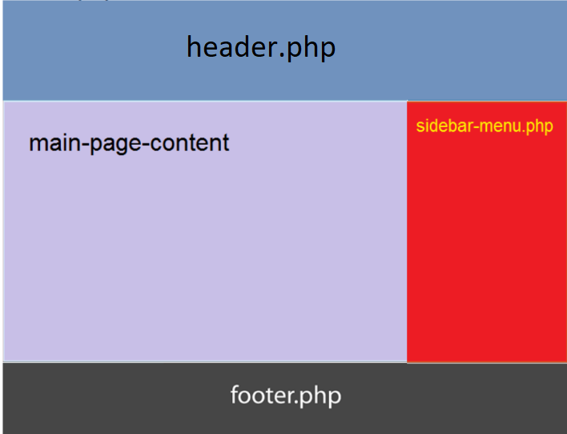
Include php
include (“header.php”);
<our content>
include (“footer.php”);

Slide 36

FREE STARTbootstrap.com
Example https://startbootstrap.com/

Slide 37
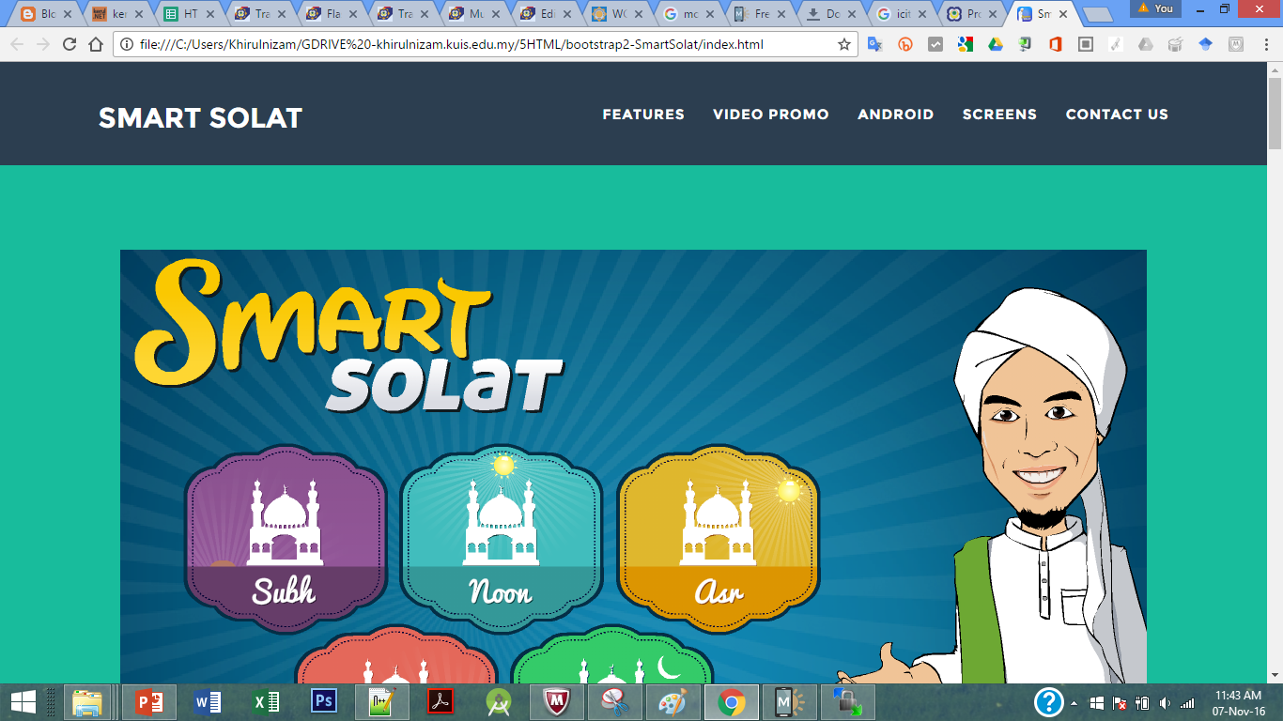
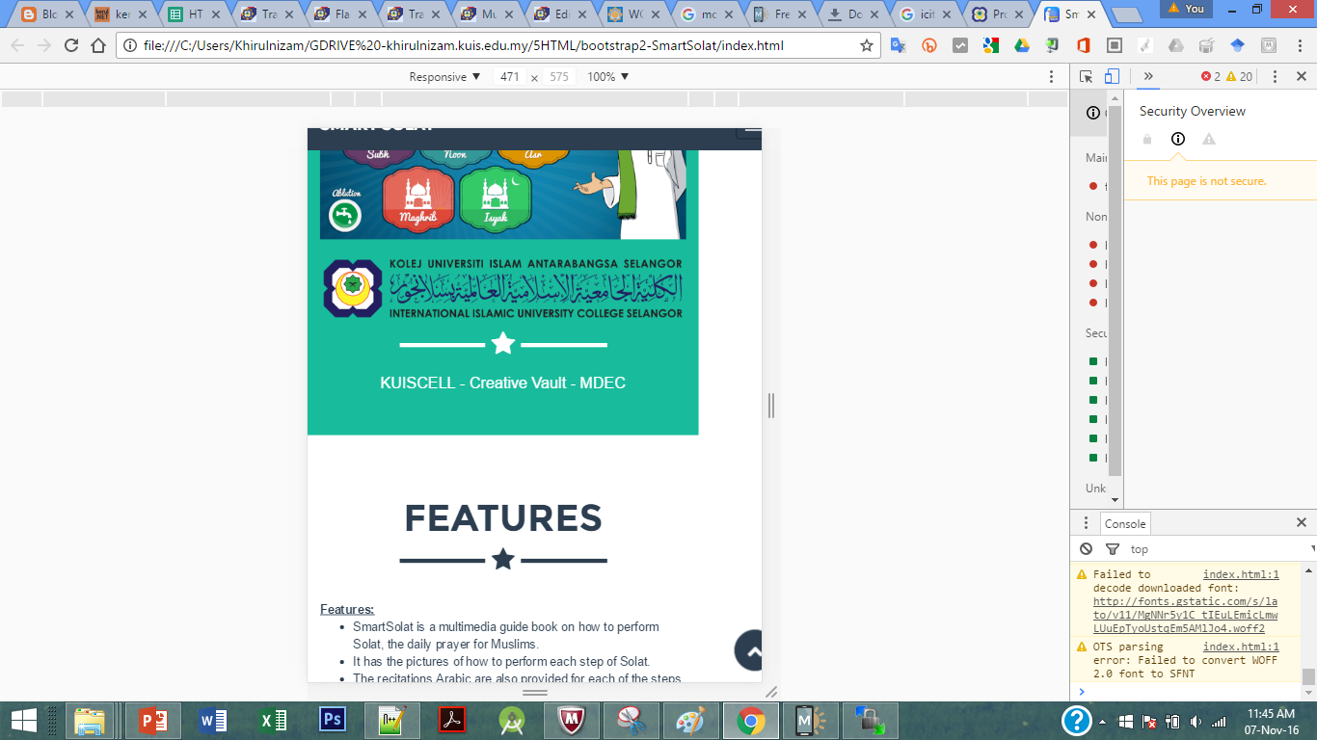
Sample2 - smartsolat

Slide 38
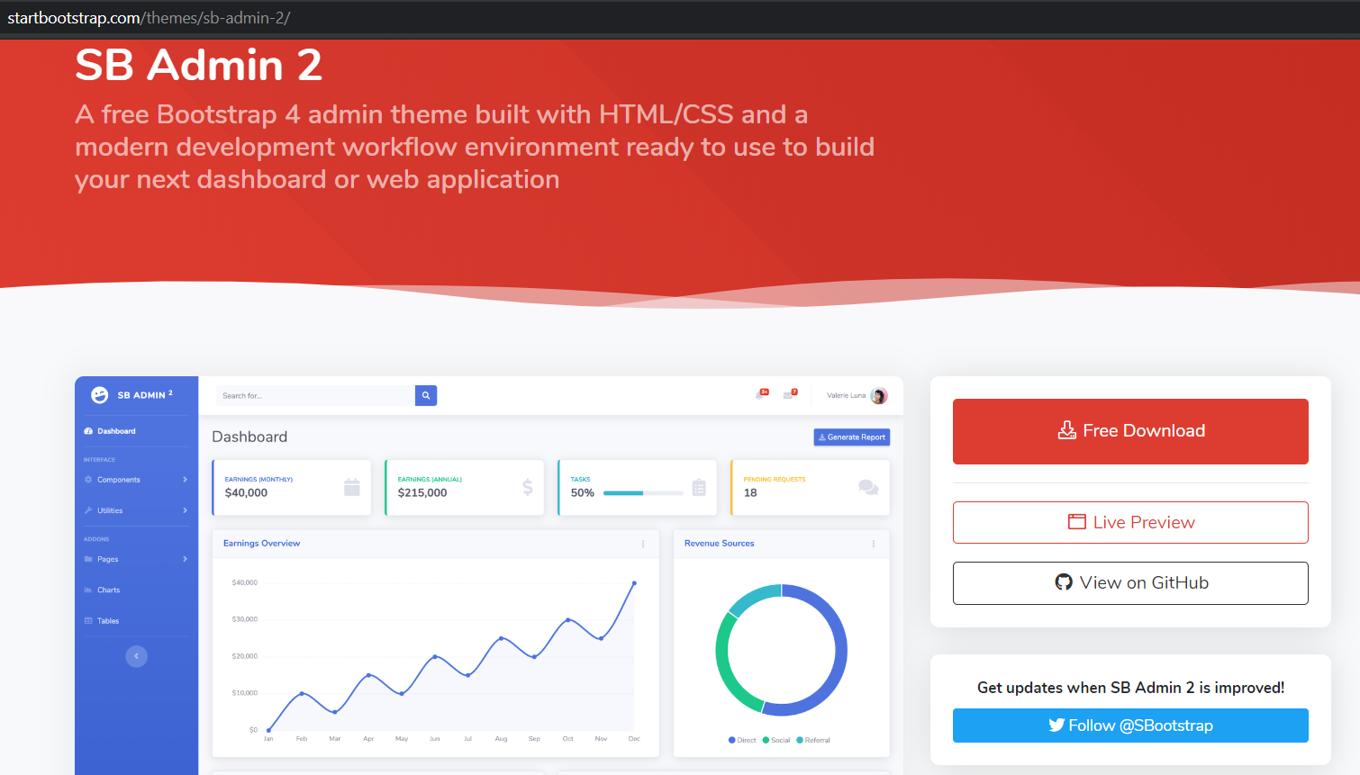
startbootstrap.com/themes/sb-admin-2/

Slide 39
T02.1 HTML + Bootstrap Form (Web Programming)
bit.ly/fstmtubephp

Slide 40
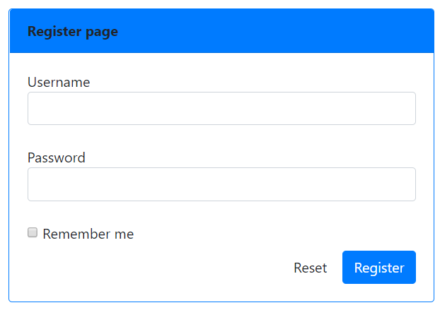
OUTPUT PREVIEW

Slide 41

DISCLAIMER
Codes are for demo purposes. Example showed here are only to validate the proof of concepts. Security aspect the demonstrated examples are beyond the coverage of these video tutorials. You are advised to explore / sought after advanced/security topics of PHP web programming as these tutorials only for beginner level.
Suitable to view in DESKTOP

Slide 42

CONNECT TO MYSQL DATABASE
mysqli
E-book PHP&Mysqli get it from
khirulnizam@gmail.com or
http://fb.com/khirulnizam or
Instagram @kerul_net
Video tutorial will cover mysqli

Slide 43
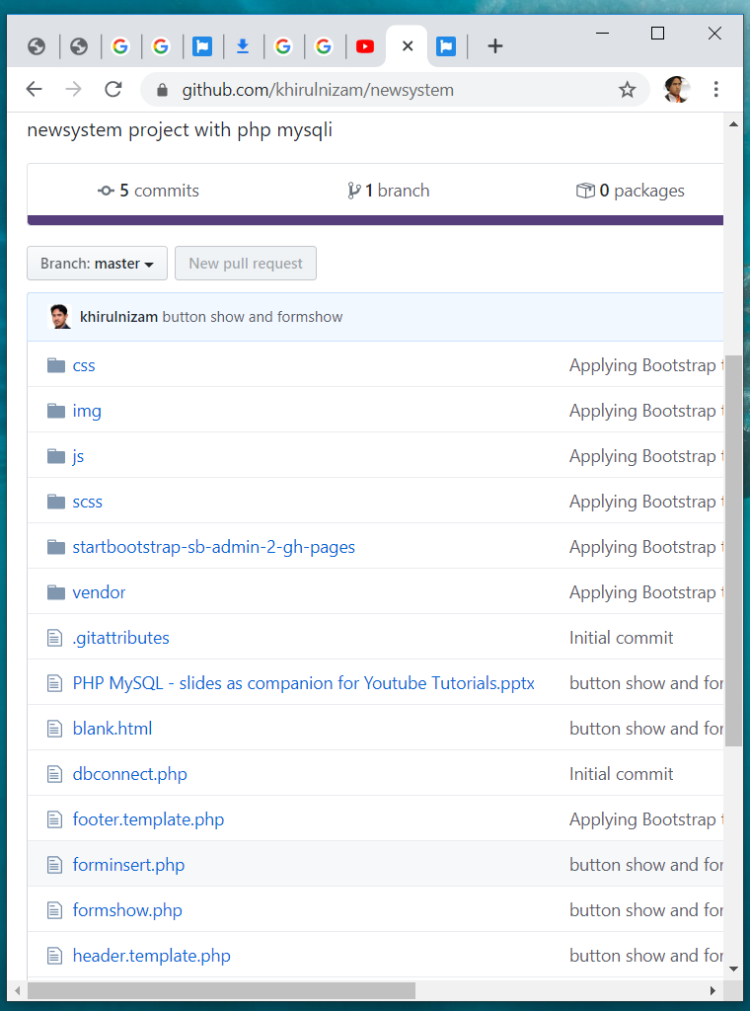

Code & Slides github.com/khirulnizam/ newsystem

Slide 44
BOOTSTRAP FORM

Slide 45
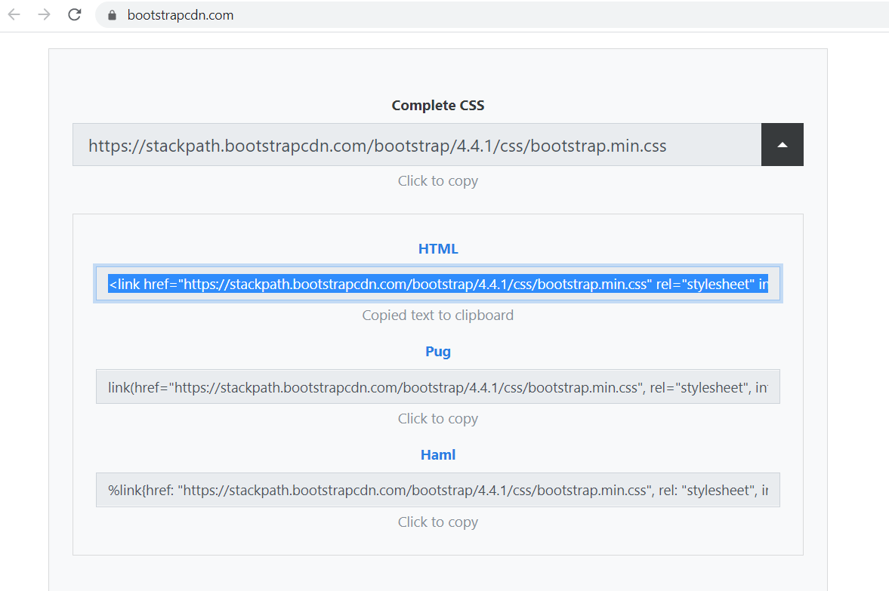
BootstrapCDN.com

Slide 46
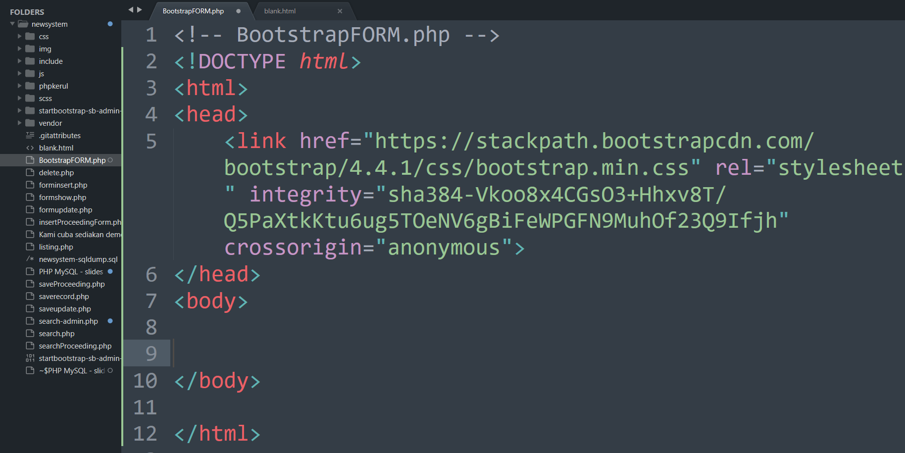

Slide 47
BootSTRAP GRID SYSTEM

Slide 48
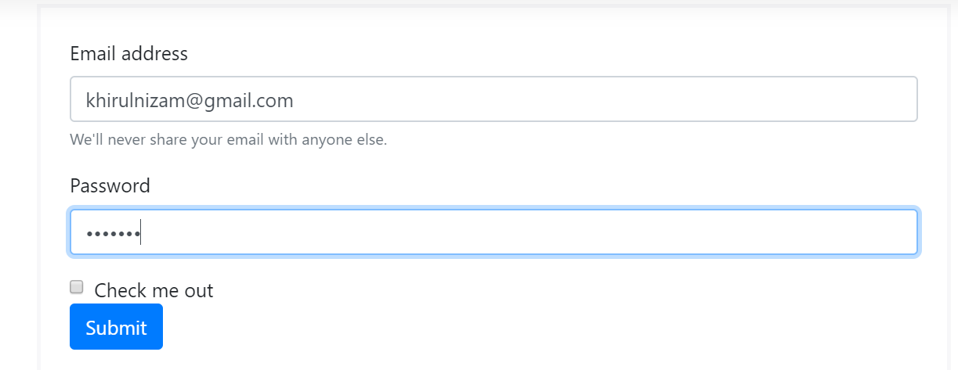
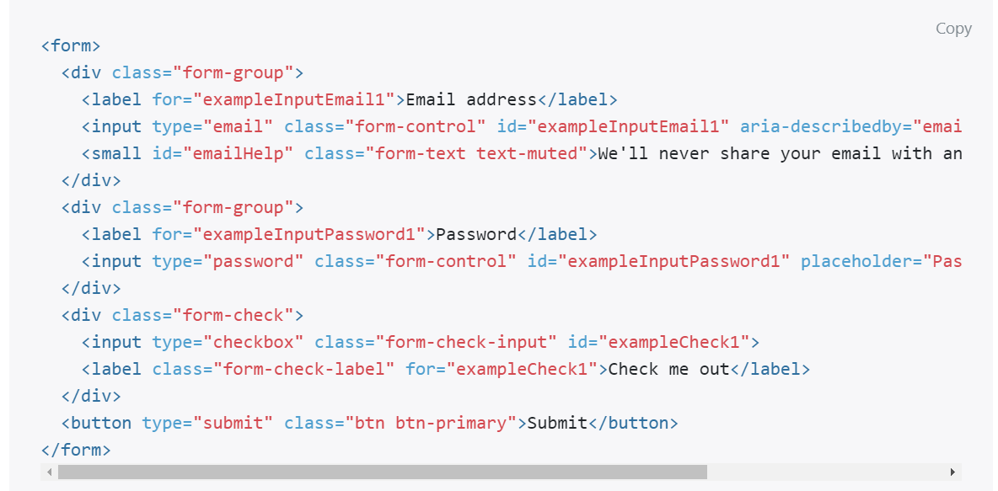
Email & PASSWORD

Slide 49
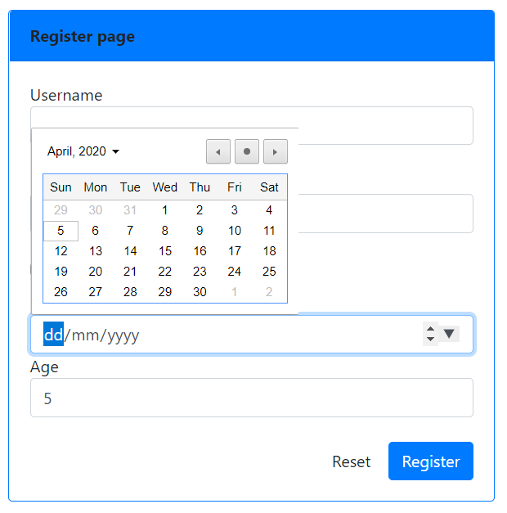
Date & NUMBER
<div >
Date of birth
<input type="date" name="dob" class="form-control">
Age
<input type="number" name="age" class="form-control">
</div>

Slide 50
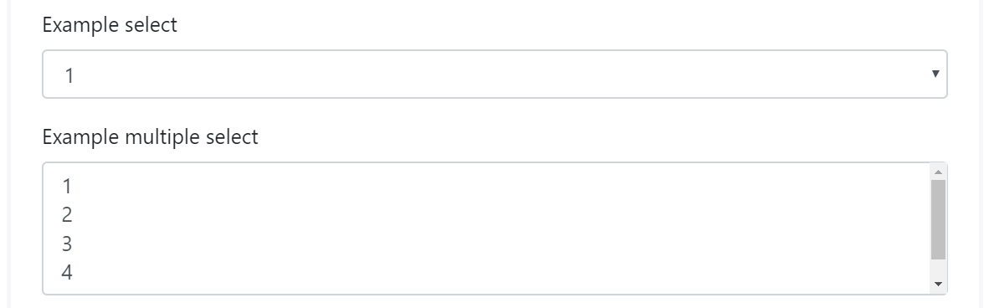
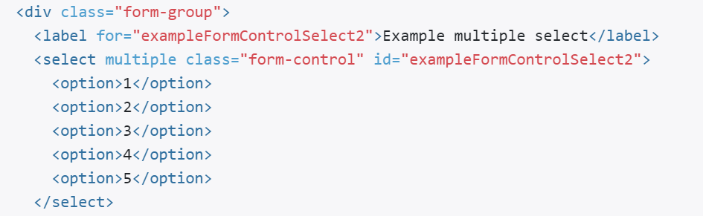
SELECT (DROP-DOWN)

Slide 51
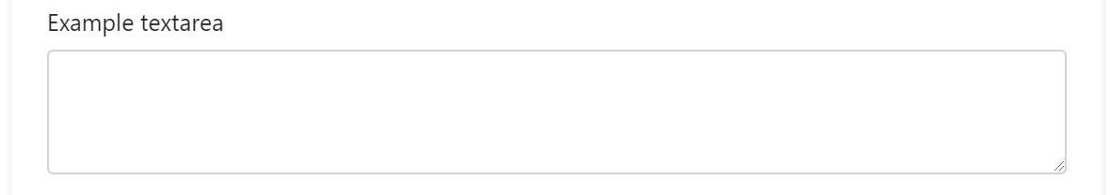
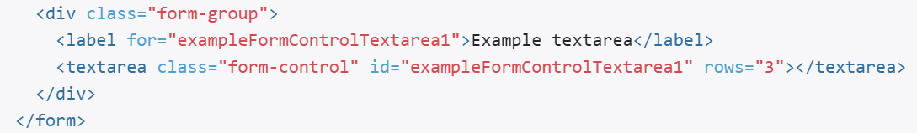
TEXTAREA

Slide 52
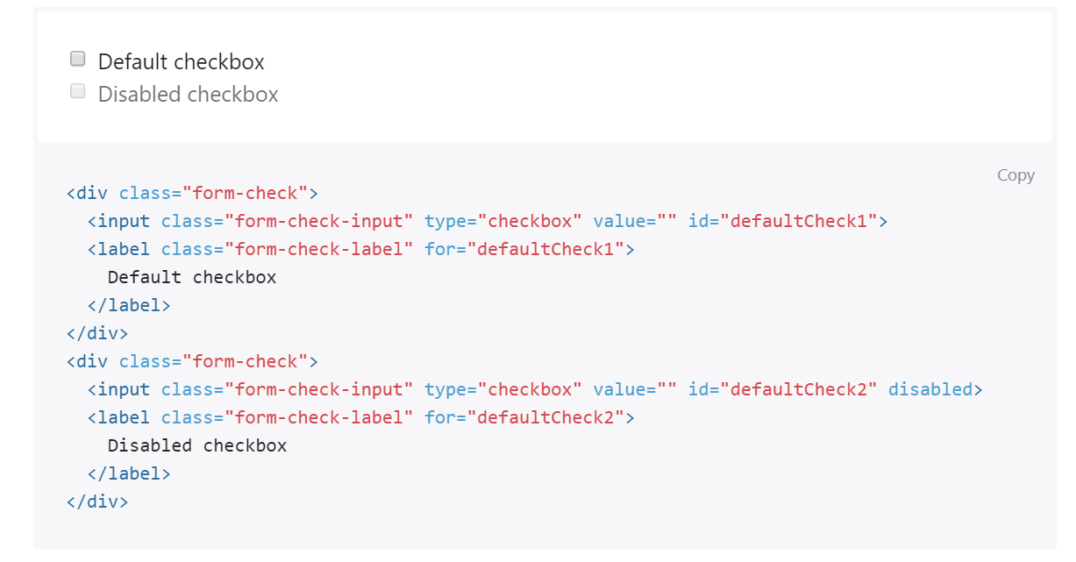
CHECKBOX

Slide 53
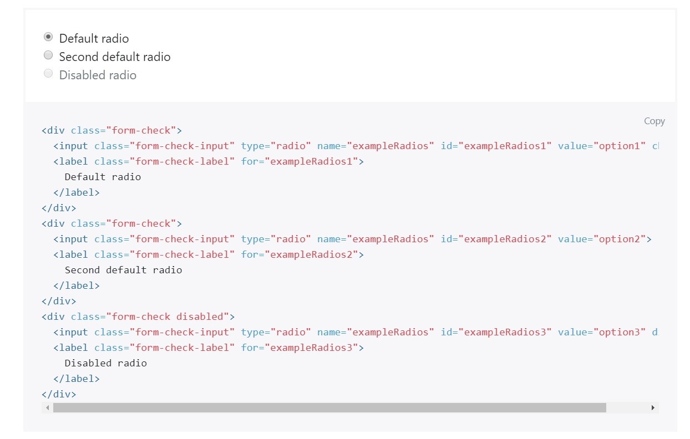
RADIO

Slide 54
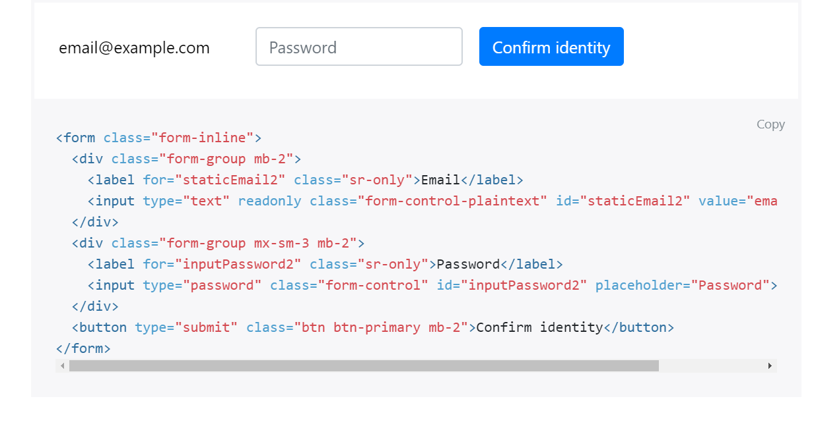
FORM-INLINE

Slide 55
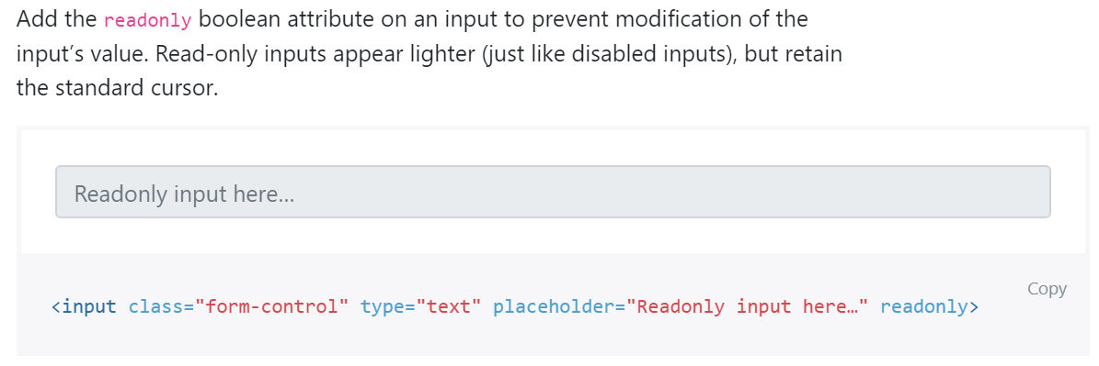
READONLY

Slide 56
DISABLED

Slide 57
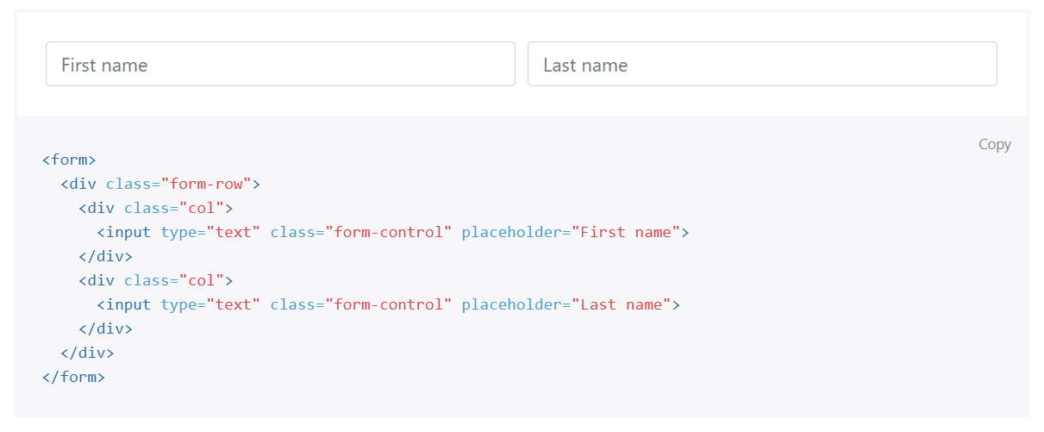
FROM GRID

Slide 58
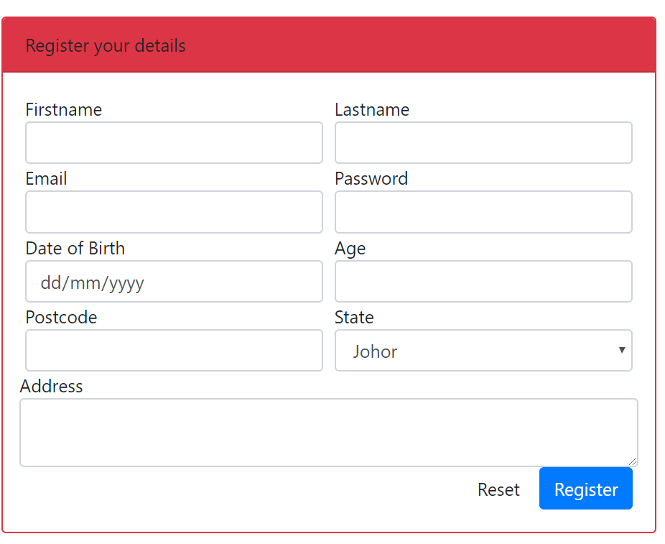
OUTPUT PREVIEW

Slide 59
T03: PHP sintaks & echo (Web Programming)
FSTM KUIS

Slide 60
T03: PHP SYNTAX & ECHO
w
FSTM KUIS

Slide 61
Introduction
What is Web programming:
Combination of server-side and client-side to develop a dynamic website.
The application is deployed in the Web environment and can be access by multiple concurrent users.

Slide 62
Introduction to PHP
PHP= PHP: Hypertext Preprocessor:
Is a server-side scripting language.
PHP scripts are executed on the server, and the output from the process is inserted to the Web page as a part of the content before transmitted to the browser.
The script will not be sent to the browser which request the Web page, so the script is not visible to the users.

Slide 63
Introduction to PHP
Server-side Scripting | Client-side scripting
The script embedded inside the HTML page, interpreted and executed inside the server (the web server) and the result/output of the execution is sent to the browser. The script interpreted and executed inside the server. E.g.: PHP, ASP. | The script embedded inside the HTML page, downloaded with the HTML page and executed on the client (browser). E.g.: JavaScript.

Slide 64
Introduction to PHP
Why PHP?
Runs on different platforms (Windows, Linux, Unix, etc.).
Is compatible with almost all servers used today (Apache, IIS, etc.).
Is free to download.
Is easier to learn and runs efficiently on the server side.

Slide 65
PHP Script Tag
A PHP scripting block always starts with <?php and ends with ?>
A PHP scripting block can be placed anywhere in the document.
On servers with shorthand support enabled ( enable in php.ini) may start a scripting block with <? and end with ?>

Slide 66
PHP Script Tag
A PHP file normally contains HTML tags, just like an HTML file, and some PHP scripting code.
Next, we have an example of a simple PHP script which sends the text “Assalamualaikum" to the browser:

Slide 67
PHP Script Tag
<html>
<head>
<title> Web Programming </title>
</head>
<body>
<?php
echo "Assalamualaikum";
?>
</body>
</html>

Slide 68
PHP Script TAG
Each code line in PHP must end with a semicolon ( ; ).
The semicolon is a separator and is used to distinguish one set of instructions from another.

Slide 69
PHP Script Tag
There are two basic statements to output text with PHP: echo and print.
In the example before, we have used the echo statement to output the text "Assalamualaikum".

Slide 70
PHP ECHO
<?php
$txt="Assalamualaikum!";
$x=23;
echo "Assalamualaikum!";
echo $x;
?>

Slide 72
T04 PHP SYNTAX //comment & $variable
FSTM KUIS

Slide 73
Comments in PHP
Comment is remark inside code that will not be compiled (ignored when the program is compiled).
It will not effect the code.
It is a good practice to write the comment.
Comment is useful the tell others what is the program is doing.
Helps programmer to memorize what is he doing.

Slide 74
Comments in PHP
In PHP, we use:
// to make a single-line comment or
/* … */ to make a large comment block.

Slide 75
Comments in PHP
<html>
<head>
<title> Web Programming </title>
</head>
<body>
<?php //This is a comment /* This is a comment block */ ?>
</body>
</html>

Slide 76
T04 SINTAKS PHP $pembolehubah $variable & concat
bit.ly/fstmtube

Slide 77
T05 SYNTAX PHP VARIABLES & CONCAT
w
FSTM KUIS

Slide 78
PHP Variables
Variables are used for storing values, like text strings, numbers or arrays.
When a variable is declared, it can be used over and over again in your script.
All variables in PHP start with a $ sign symbol.
The correct way of declaring a variable in PHP:
Eg: $var_name = "Kerul";

Slide 79
PHP Variables (cont)
New PHP programmers often forget the
$
sign at the beginning of the variable.
In that case it will not work.
Let's try creating a variable containing a string and a variable containing a number:

Slide 80
PHP Variables (cont)
<?php
$txt="Assalamualaikum!";
$x=23;
echo $txt;
?>

Slide 81
EXAMPLE ON VARIABLE
Write the echo( )statement to display the following message:
Assalamualaikum!23

Slide 82
Naming Rules for Variables
A variable name must start with a $
A variable name can only contain alpha-numeric characters and underscores (a-z, A-Z, 0-9, and _ ).
A variable name should contain no space.
If a variable name is more than one word, it should be separated with an underscore ($my_string), or with capitalization ($myString).

Slide 83
EXAMPLE
Decide whether the following variables are valid or invalid. Give your reason.
$apa 11) $my_books
$123lekuk 12) $_myFamily
$what-is-the-number 13) $my address
$_uji1 14) $my2numbers
$my name
$For
IF
$float
$variable_to_hold_names_or_matrix_for_students
$hasil*nombor

Slide 84
Lateral Values
Lateral is the exact/actual value.
The value could be number (integer or real), character, string, or Boolean.

Slide 85
Lateral Values (cont)
Integer:
Integer is round number.
For example, 10 is an integer.
E.g.:
$num = 10;
$num = -10;
Use negative sign for negative numbers.

Slide 86
Lateral Values (cont)
Float:
E.g.:
$temp = 21.1225;
$product = 0.0;

Slide 87
Lateral Values (cont)
Characters:
To assign a character value into a char variable, the value must be put inside a open and close single or double quote.
E.g.:
$nama = 'Encik';
$name = "Kerul";

Slide 88
Lateral Values (cont)
Boolean:
There are only two values for Boolean variable: true and false.
E.g.:
$eatalready = true;
$isInteger = false;

Slide 89
Lateral Values (cont)
String:
A group of characters.
Marked with single or double quote.
E.g.:
$stmt = "How are you";

Slide 90
Concatenation Operator
There is only one string operator in PHP.
The concatenation operator ( . ) is used to put two string values together.
To concatenate two string variables together, use the concatenation operator:

Slide 91
Concatenation (cont)
<?php $txt1="Assalamualaikum!"; $txt2="Have a nice day!";
echo $txt1 . " " . $txt2; ?>

Slide 92
Concatenation (cont)
The simpler way in doing concatenation:
<?php $txt1="Assalamualaikum!"; $txt2="Have a nice day!";
echo "$txt1 $txt2"; ?>

Slide 93
Concatenation (cont)
Or, if you want to print the output in a separate line:
<?php $txt1="Assalamualaikum!"; $txt2="Have a nice day!";
echo "$txt1 <br> $txt2"; ?>

Slide 94
Concatenation (cont)
Array:
<?php $num[0]=3;
echo "Number ".$num[0];
echo "Number $num[0] ";//not possible
?>

Slide 95
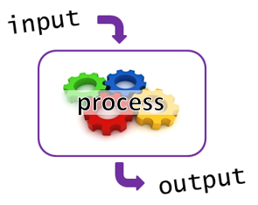
T05+1 Input Process Output
bit.ly/fstmtube

Slide 96
I-P-O
Input data
Process the data by converting into information
Output – convey the information as something meaningful

Slide 97
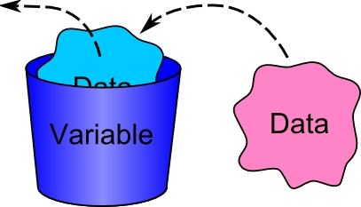
PHP Variables
Variables are used for storing values, like text strings, numbers or arrays.
All variables in PHP start with a $ sign symbol.
The correct way of declaring a variable in PHP:
Eg: $num1= 3; $num2=5;

Slide 98
Naming Rules for Variables
A variable name must start with a $
A variable name can only contain alpha-numeric characters and underscores (a-z, A-Z, 0-9, and _ ).
A variable name should contain no space.
If a variable name is more than one word, it should be separated with an underscore ($my_string), or with capitalization ($myString).

Slide 99
Arithmetic Operations
Operator | Operation | Example
 |  | Mathematical expression | PHP expression
+ | Addition | num1 + 3 | $total=$n1 + $n2;
- | Subtraction | pi - y | $q=$pi - $y;
* | Multiplication | width x height | $area=$width * $height;
/ | Division | a/b | $div=$a/$b;
% | Modulus | num modulo 2 | $even=$nom%3;

Slide 100
PROCESS: ADD 2 NUMBERS
Input process output
$num2 3
$num1 5
$total 8

Slide 101
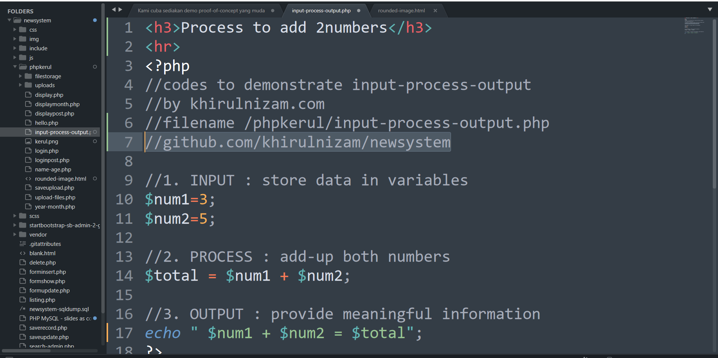
github.com/khirulnizam/newsystem

Slide 102
T06 FORM INPUT
w
bit.ly/fstmtube

Slide 103
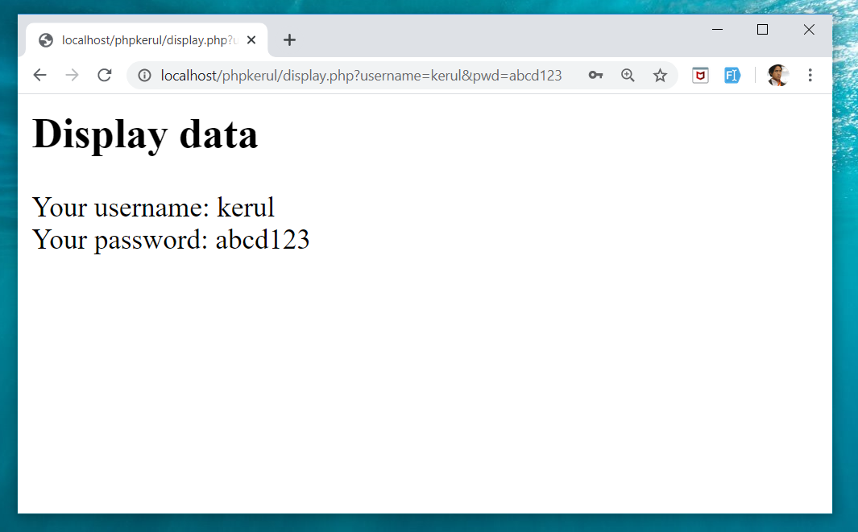
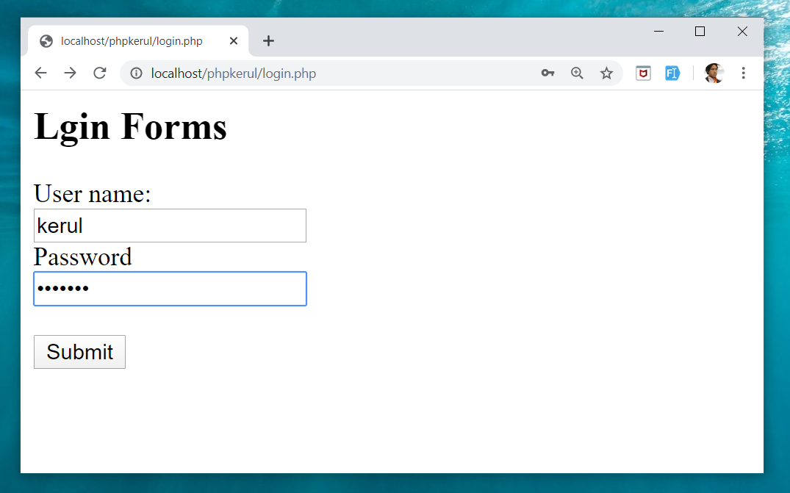
Example (cont)

Slide 104
Input Through HTML
<form name=“aform” method=“GET” action=“save.php”>
input…
</form>
This is the typical structure of form:
name: is the name of the form.
method: how the data is transferred (POST or GET).
action: is the target file resides in the Web server that receive the data from the form.
input: are the input elements (text field, checkbox, radio button, etc.).

Slide 105
GET vs. POST
GET | POST
Is basically for just getting (retrieving) data. The variable name and the value appear and visible in the URL. Form data is to be encoded (by a browser) into at the end of the URL of the target file. | Form data is embedded within a message body. POST may involve anything, like storing files to the server, updating data, ordering a product, or sending an e-mail. The variable name and the value do not appear in the URL.

Slide 106
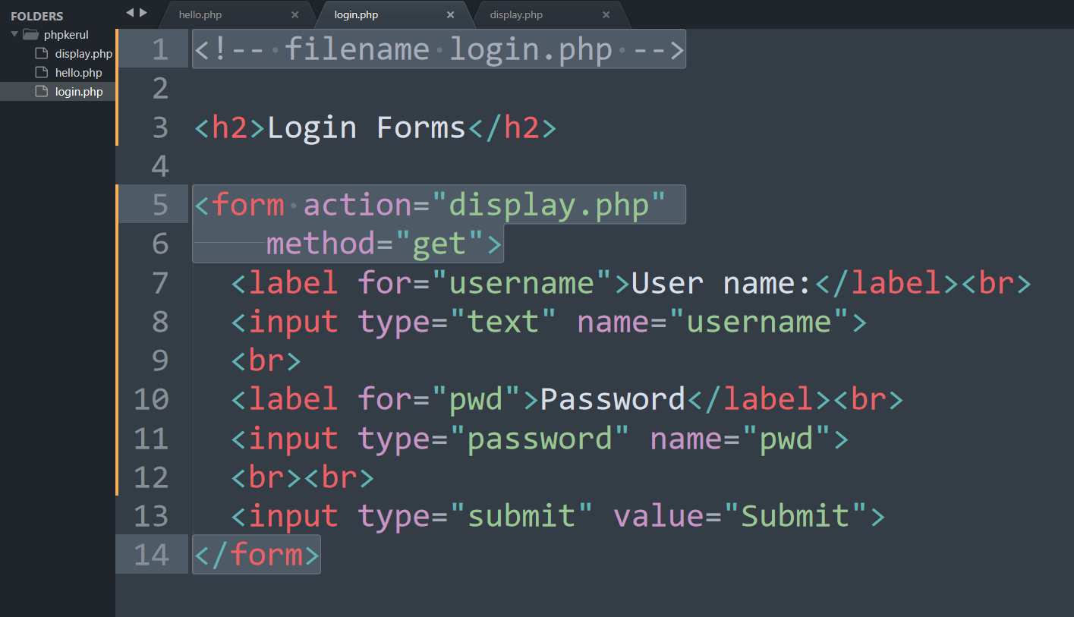
Example (Using GET Method)

Slide 107
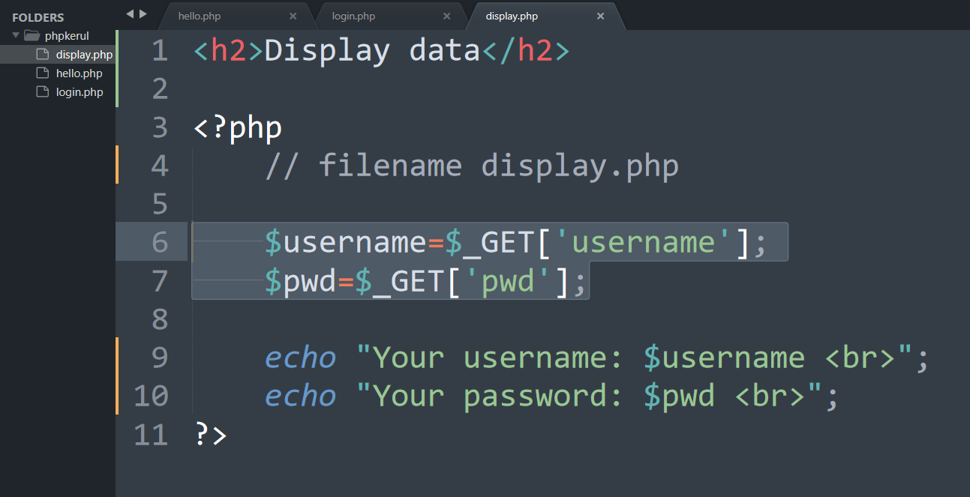
Display.php

Slide 108
Example (cont)

Slide 109
Example (Using POST Method)

Slide 110
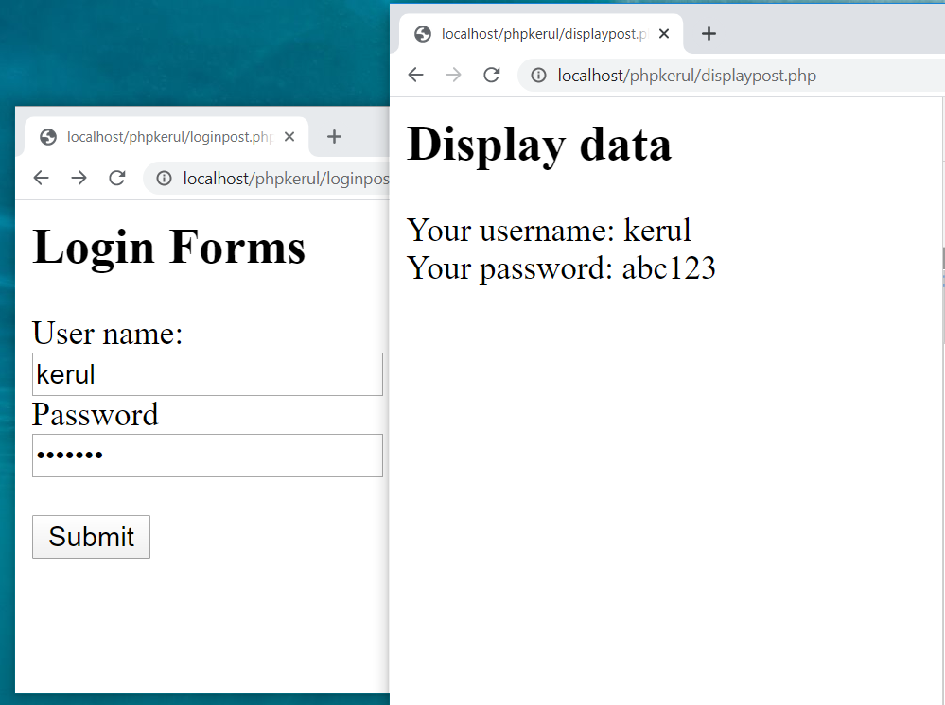

Slide 111
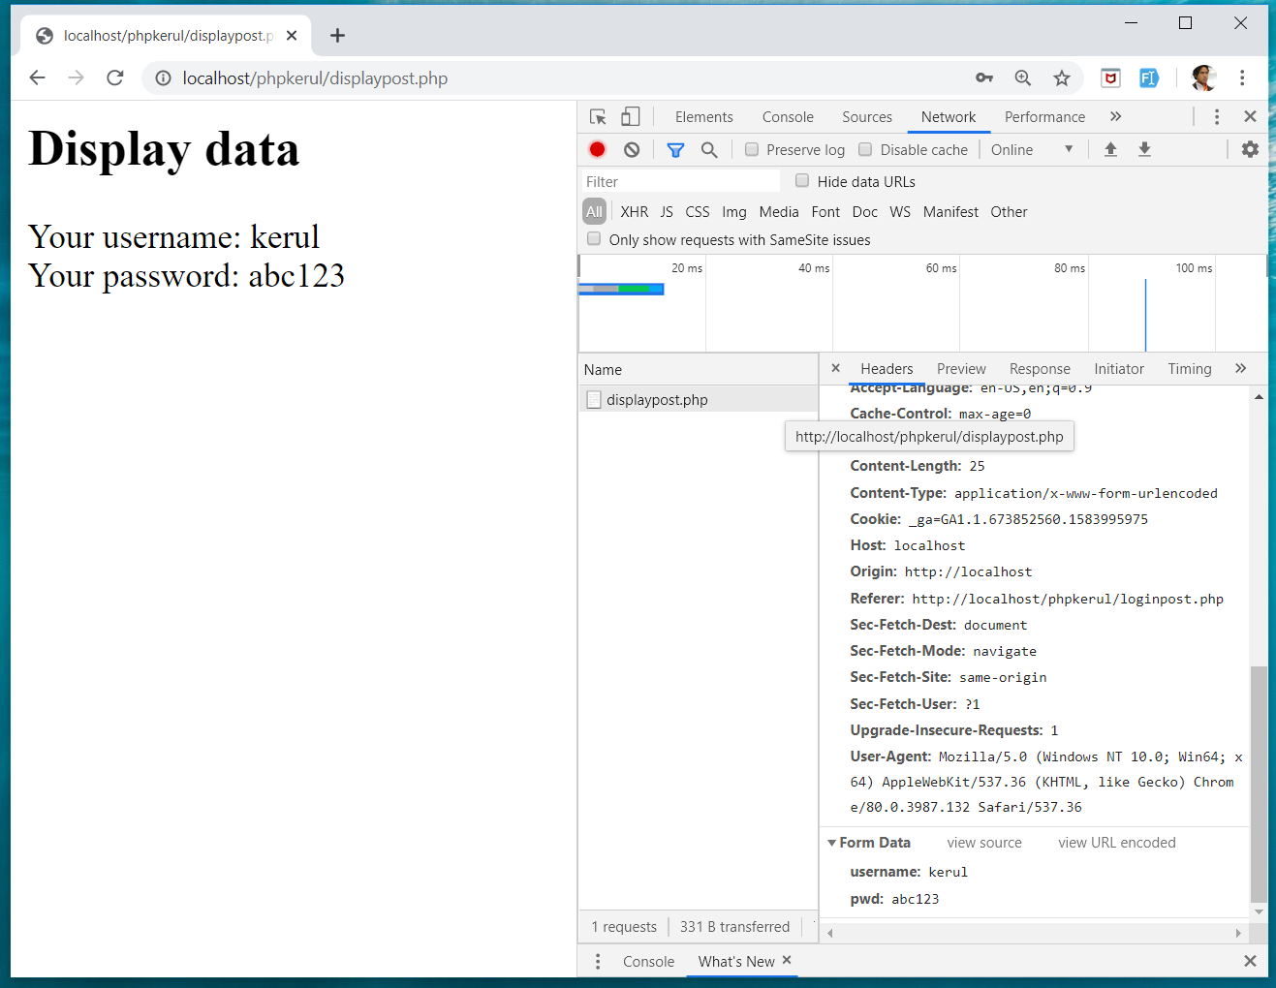
INSPECT TOOLS
F12

Slide 112
T07 SELECTION (PILIHAN) IF…Else
w
bit.ly/fstmtube

Slide 113
Comparison Operators
Operator | Meaning | Example
== | Equal to | ($num == 100)
!= | Not equal to | ($letter != ‘Z’)
< | Less than | ($num1 < $num2)
> | Greater than | ($mark > 80)
<= | Less than or equal to | ($sum <= 10)
>= | Greater than or equal to | ($sum >= $input)

Slide 114
Selection in PHP
if is a PHP reserved words to perform selection:
Simple if: for one choice selection
if…else: for two choices selection

Slide 115
Simple if
E.g.:
if ($grade == 'A')
echo 'Excellent';
else if ($grade == 'F')
echo 'Try again’;
else

Slide 116
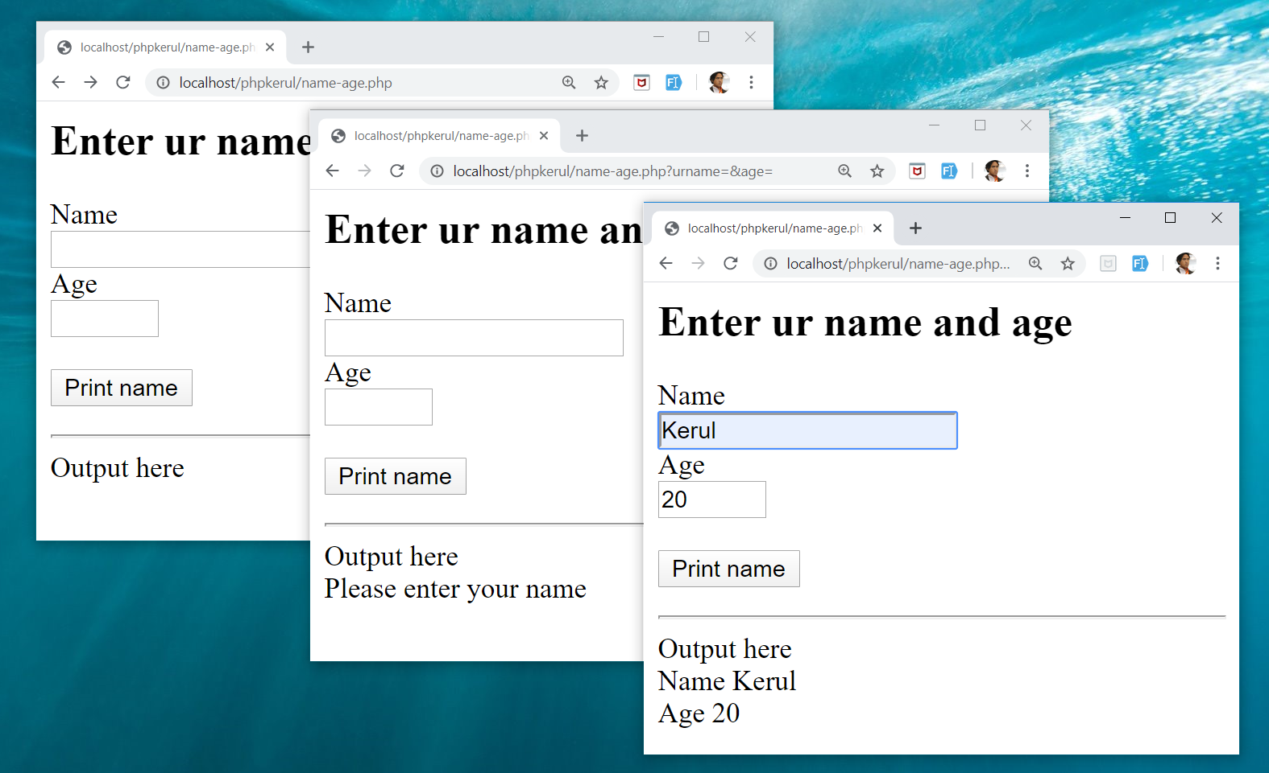
Example

Slide 117
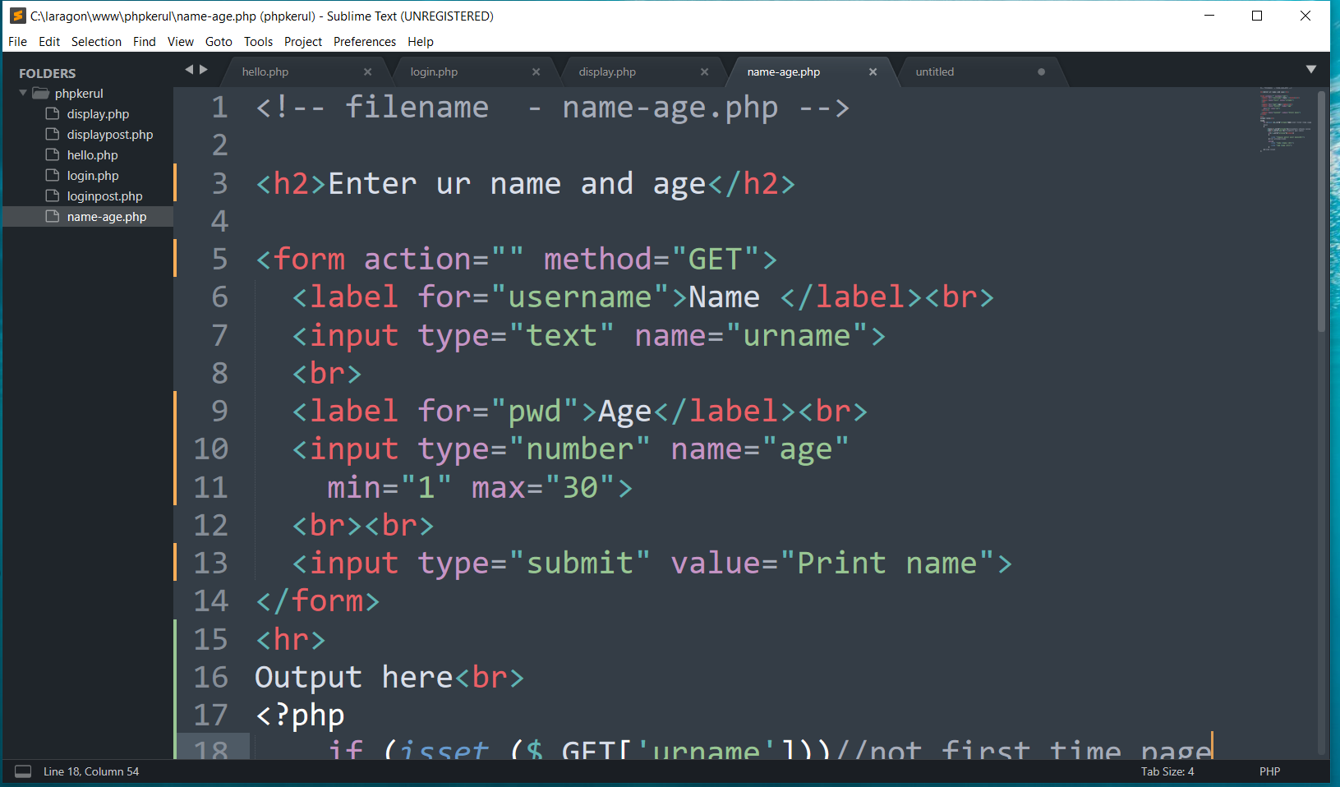
FORM (name-age.php )

Slide 118
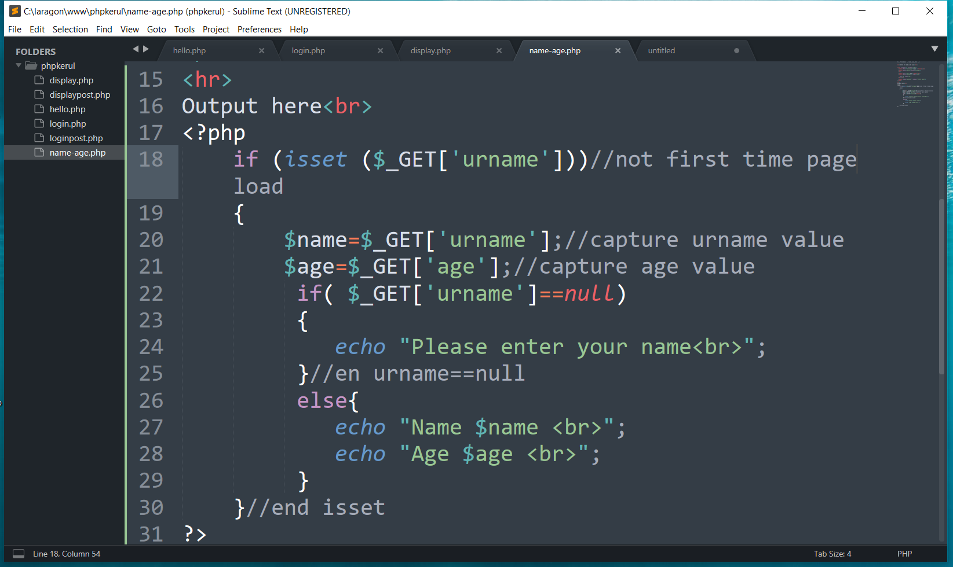
THE PHP IF…ELSE

Slide 119
T08 ITERATION (ULANGAN) FOR LOOp
w
bit.ly/fstmtube

Slide 120
Repetition in PHP
There are many ways of doing repetition. Three of them:
for
while and do…while
foreach

Slide 121
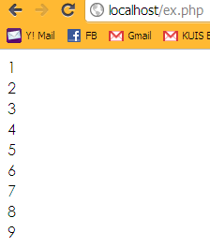
for structure
E.g.:
<?php
for ($i=1; $i<=9;$i++){
echo "$i<br>";
}
?>

Slide 122
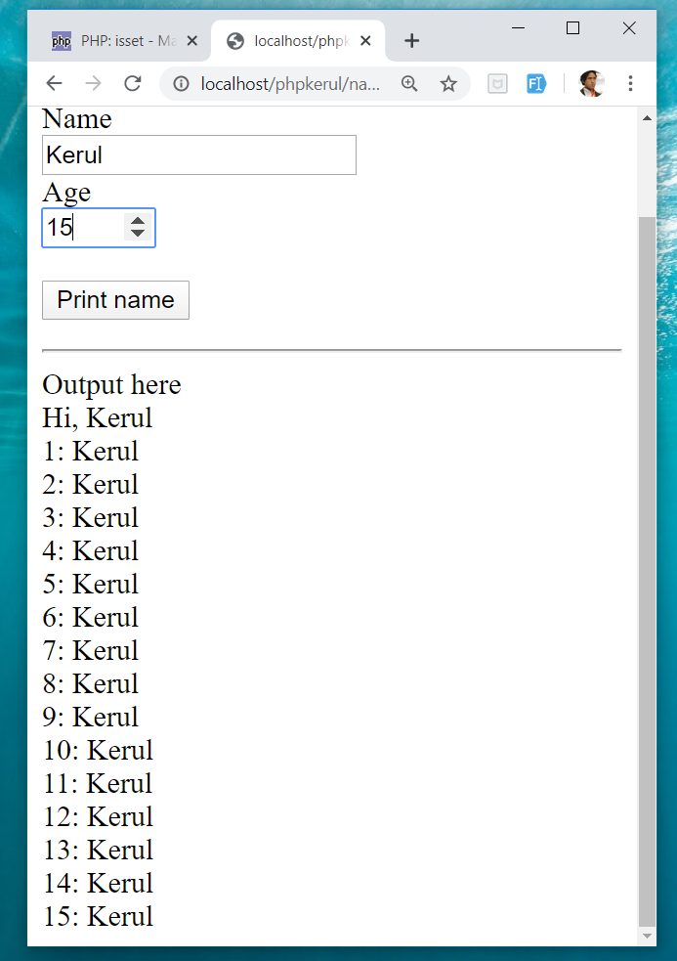
OUTPUT SAMPLE

Slide 123
T09 ARRAY (TATASUSUNAN) FOREACH
w
bit.ly/fstmtube

Slide 124
Introduction of Array
A variable is a storage area holding a number or text. The problem is a variable hold only one value.
An array is a special variable, which can store multiple values in one single variable.

Slide 125
Introduction of Array (cont)
If you have a list of items (a list of student names, for e.g.), storing the student names in single variables could look like this:
$std1="Anas"; $std2="Hajar"; $std3="Shah";

Slide 126
Introduction of Array
In PHP, there are 3 kind of arrays:
Numeric array - An array with a numeric index.
Assign using AUTOMATIC method.
Assign using MANUAL method.
Associative array - An array where each ID key is associated with a value.
Multidimensional array - An array containing one or more arrays.

Slide 127
Numeric Array
Assign using AUTOMATIC method (the index starts at 0).
$std = array("Anas", "Hajar", "Shah", "Nurul");
Assign using MANUAL method.
$std[0]="Anas"; $std[1]="Hajar"; $std[2]="Shah"; $std[3]="Nurul";

Slide 128
Example
<?php
$std[0]="Anas";
$std[1]="Hajar";
$std[2]="Shah";
$std[3]="Nurul";
echo $std[0] . " and " . $std[1] . " are students of FSTM.";
?>

Slide 129

Associative Array
$record['rollno' ]=5;
$record['name']="Kerul";
$record['phone’]=90346;

Slide 130


DISPLAY YEARS in DROPDOWN

Slide 131

SELECT
OPTION

Slide 132

FOREACH

Slide 133
T10 FILE UPLOAD (MUAT-NAIK FAIL)
w
bit.ly/fstmtube

Slide 134
DISCLAIMER
Codes are for demo purposes. Example showed here are only to validate the proof of concepts. Security aspect the demonstrated examples are beyond the coverage of these tutorials. You are advised to explore / sought after advanced topics of PHP web programming as the issues are covered in the advanced level.

Slide 135
move_uploaded_file function
The move_uploaded_file() function moves an uploaded file to a new location.
This function returns TRUE on success, or FALSE on failure.
Syntax:
move_uploaded_file(file,newloc)
file: Specifies the file name.
newloc: Specifies the new location (destination) for the file.

Slide 136
PHP.ini
In php settings ( locate file php.ini from Laragon), turn-on the file upload
file_uploads = On

Slide 137
UPLOAD FORM (ONLY FOR IMAGE)
<!DOCTYPE html> <html> <body> <form action= "saveupload.php" method="post" enctype="multipart/form-data"> Select image to upload: <input type="file" name="fileToUpload" <input type="submit" value="Upload Image" name="submit"> </form> </body> </html>

Slide 138

enctype
enctype="multipart/form-data" - POST request with file-upload, have to encode the data that forms the body of the request.
<input name="fileToUpload" type="file" > - the form control to choose a file and upload to server.

Slide 139

OUTPUT

Slide 140

PHP to store image in server
Source: www.w3schools.com/php/php_file_upload.asp

Slide 141

PHP to store image in server
Source: www.w3schools.com/php/php_file_upload.asp

Slide 142

PHP to store image in server
Source: www.w3schools.com/php/php_file_upload.asp

Slide 143
OUTPUT

Slide 144

T11 php OOP (PENGATURCARAAN BERASASKAN OBJEK)
bit.ly/fstmtube

Slide 145





OOP
Object Oriented Programming - We can imagine our surroundings are full of objects cars, trees, houses, etc. Same way there is object oriented programming concepts which assume everything as an object and implement a software/system parts using different objects.
w3schools

Slide 146



FUNCTION IN PHP
A function is a block of statements that can be used repeatedly in a program.
Without arguments.
With arguments.

Slide 147
MODULAR PHP FUNCTION
Tokenization
Post Tagging
Vocab
Outside Vocab
Annotati
Output generation
Input file

Slide 148
Class
PHP OOP
Methods
Properties
Classes and objects are the two main aspects of object-oriented programming.
Class
Method/function
Object call
Constructor
Static method/property
Inheritance

Slide 149

PHP Class

Slide 150

CLASS Method

Slide 151


PHP Class with Constructor

Slide 152
PHP Object Call

Slide 153


STATIC METHOD/PROPERTIES
w3schools

Slide 154

INHERITANCE
Inheritance in OOP = When a class derives from another class.
The child class will inherit all the public and protected properties and methods from the parent class. In addition, it can have its own properties and methods.
An inherited class is defined by using the extends keyword.
Parent /
Superclass
Child/Subclass

Slide 155

EXAMPLE ON INHERITANCE

Slide 156

INHERITANCE: PHP FRAMEWORK
bit.ly/fstmtubelaravel

Slide 157

T12 PREPARING MYSQL DATABASE SERVER (PANGKALAN DATA)
bit.ly/fstmtubephpmysql

Slide 158

T12 PREPARING MYSQL DATABASE SERVER (PANGKALAN DATA)
bit.ly/fstmtubephpmysql

Slide 159
DISCLAIMER
Codes are for demo purposes. Example showed here are only to validate the proof of concepts. Security aspect the demonstrated examples are beyond the coverage of these tutorials. You are advised to explore / sought after advanced/security topics of PHP web programming as these tutorials only for beginner level.

Slide 160
CONNECT TO MYSQL DATABASE
mysqli/PDO
E-book PHP&Mysqli get it from
khirulnizam@gmail.com or
http://fb.com/khirulnizam or
Instagram @kerul_net
These vids tutorial will cover mysqli/PDO

Slide 161

CHANGE DBSERVER ROOT PASSWORD

Slide 162

ENTER PASSWORD

Slide 163


START ALL

Slide 164


CREATE NEW DB

Slide 165

HEIDI SQL (MYSQL CILENT)

Slide 166

CREATE NEW TABLE
Right-click on dbname

Slide 167

TABLE STRUCTURE : STUDENTS
Table name: students
set auto_increment for field id

Slide 168

POPULATE DUMMY DATA
Right-click to insert new row

Slide 169
T13 DBCONNECT PDO (PANGKALAN DATA PDO)
bit.ly/fstmtubephpmysql

Slide 170
T13 DBCONNECT PDO (PANGKALAN DATA PDO)
bit.ly/fstmtubephpmysql

Slide 171
DISCLAIMER
Codes are for demo purposes. Example showed here are only to validate the proof of concepts. Security aspect the demonstrated examples are beyond the coverage of these tutorials. You are advised to explore / sought after advanced/security topics of PHP web programming as these tutorials only for beginner level.

Slide 172
CONNECT TO MYSQL DATABASE
mysqli/PDO
E-book PHP&Mysqli get it from
khirulnizam@gmail.com or
http://fb.com/khirulnizam or
Instagram @kerul_net
These vids tutorial will cover mysqli/PDO

Slide 173

WHY PDO ?
PDO – PHP Data Object
Support different database
mysqli – only for MySQL
database connection
https://www.php.net/manual/en/book.pdo.php

Slide 174

TEST DBCONNECT TO DATABASE

Slide 175

HOW TO DISPLAY ALL RECORDS

Slide 176

EMBED SQL STATEMENT

Slide 177

SUBSCRIBE FSTM KUIS CHANNEL

Slide 178
T14 DBCONNECT using mysqli (Pangkalan Data mysqli)
bit.ly/fstmtubephpmysql

Slide 179
STAY HOME5, SAVE MALAYSIA! t14: mysqli
bit.ly/fstmphpmysqli

Slide 180
DISCLAIMER
Codes are for demo purposes. Example showed here are only to validate the proof of concepts. Security aspect the demonstrated examples are beyond the coverage of these tutorials. You are advised to explore / sought after advanced/security topics of PHP web programming as these tutorials only for beginner level.
Suitable to view in DESKTOP

Slide 181
CONNECT TO MYSQL DATABASE
mysqli
E-book PHP&Mysqli get it from
khirulnizam@gmail.com or
http://fb.com/khirulnizam or
Instagram @kerul_net
These vids tutorial will cover mysqli

Slide 182
3-tier – DATABASE CONNECTION
Tier3 : Database
Tier1 : Client/browser
Tier2 : Middleware (Webserver + PHP)

Slide 183

CREATE NEW DB

Slide 184

PREPARE DATABASE NAME & TABLE

Slide 185
mysqli_connect ( )
<?php
$servername = "localhost";//server location / IP number
$username = "root";//db admin username
$password = "abcd1234";//password for db admin username
$dbname = "newsystem";//database name
// Create connection
$conn = mysqli_connect($servername, $username,
$password, $dbname);

Slide 186

mysqli_connect ( )

Slide 187

TEST SQL COMMANDS

Slide 188
MSQLI FUNCTIONS
$result = mysqli_query($conn, $sql)
PHP.net/mysqli_query : Performs an SQL query on the database
if (mysqli_num_rows($result) > 0)
PHP.net/mysqli_num_rows : Gets the number of rows in a result
while($row = mysqli_fetch_assoc($result)) {
PHP.net/mysqli_fetch_assoc : Fetch a result row as an associative array

Slide 189
Associative Array
$record['rollno']=5;
$record['name']="Kerul";
$record['phone’]=90346;

Slide 190

EMBED SQL IN PHP

Slide 191

DISPLAY RESULT SET

Slide 192
SUBSCRIBE FSTM KUIS CHANNEL

Slide 193
T15 SEARCH IN DB (Carian dalam DB)
bit.ly/fstmtubephpmysql

Slide 194
DISCLAIMER
Codes are for demo purposes. Example showed here are only to validate the proof of concepts. Security aspect the demonstrated examples are beyond the coverage of these video tutorials. You are advised to explore / sought after advanced/security topics of PHP web programming as these tutorials only for beginner level.
Suitable to view in DESKTOP

Slide 195
CONNECT TO MYSQL DATABASE
mysqli
E-book PHP&Mysqli get it from
khirulnizam@gmail.com or
http://fb.com/khirulnizam or
Instagram @kerul_net
Video tutorial will cover mysqli

Slide 196
Code & Slides github.com/khirulnizam/ newsystem

Slide 197

CODE: search.php

Slide 198

POPULATE DATA INSIDE TABLE

Slide 199
Next

Slide 200

T16 BOOTSTRAP TEMPLATE
bit.ly/fstmtphpmysqli

Slide 201
EXAMPLE OF IMPLEMENTATION

Slide 202
GITHUB
https://github.com/khirulnizam/newsystem

Slide 203
DISCLAIMER
Codes are for demo purposes. Example showed here are only to validate the proof of concepts. Security aspect the demonstrated examples are beyond the coverage of these video tutorials. You are advised to explore / sought after advanced/security topics of PHP web programming as these tutorials only for beginner level.
Suitable to view in DESKTOP

Slide 204
CONNECT TO MYSQL DATABASE
mysqli
E-book PHP&Mysqli get it from
khirulnizam@gmail.com or
http://fb.com/khirulnizam or
Instagram @kerul_net
Video tutorial will cover mysqli

Slide 205
Include php
include ("header.php");
<our content>
include ("footer.php");

Slide 206
startbootstrap.com/themes/sb-admin-2/

Slide 207
EXAMPLE OF IMPLEMENTATION

Slide 208

T17 INSERT RECORD (MASUKKAN REKOD BAHARU)
bit.ly/fstmtphpmysqli

Slide 209
EXAMPLE OF IMPLEMENTATION

Slide 210
GITHUB
https://github.com/khirulnizam/newsystem

Slide 211
DISCLAIMER
Codes are for demo purposes. Example showed here are only to validate the proof of concepts. Security aspect the demonstrated examples are beyond the coverage of these video tutorials. You are advised to explore / sought after advanced/security topics of PHP web programming as these tutorials only for beginner level.
Suitable to view in DESKTOP

Slide 212
CONNECT TO MYSQL DATABASE
mysqli
E-book PHP&Mysqli get it from
khirulnizam@gmail.com or
http://fb.com/khirulnizam or
Instagram @kerul_net
Video tutorial will cover mysqli

Slide 213
OVERVIEW

Slide 214

forminsert.php

Slide 215

forminsert.php

Slide 216

forminsert.php

Slide 217

INSERT INTO

Slide 218

T18 SHOW DETAILS (Paparan semua data rekod)
bit.ly/fstmphpbootstrap

Slide 219

OVERVIEW

Slide 220
DISCLAIMER
Codes are for demo purposes. Example showed here are only to validate the proof of concepts. Security aspect the demonstrated examples are beyond the coverage of these video tutorials. You are advised to explore / sought after advanced/security topics of PHP web programming as these tutorials only for beginner level.
Suitable to view in DESKTOP

Slide 221
CONNECT TO MYSQL DATABASE
mysqli
E-book PHP&Mysqli get it from
khirulnizam@gmail.com or
http://fb.com/khirulnizam or
Instagram @kerul_net
Video tutorial will cover mysqli

Slide 222
Code & Slides github.com/khirulnizam/ newsystem

Slide 223
OVERVIEW

Slide 224
search-admin.php

Slide 225


Slide 226
formshow.php

Slide 227


Slide 228


Slide 229


Slide 230
Code & Slides github.com/khirulnizam/ newsystem

Slide 231

T19 UPDATE RECORD (Kemaskini data rekod)
bit.ly/fstmphpbootstrap

Slide 232

UPDATE RECORD PROCESS
search-admin.php
id
id

Slide 233
OVERVIEW
Cancel
Save Record

Slide 234
DISCLAIMER
Codes are for demo purposes. Example showed here are only to validate the proof of concepts. Security aspect the demonstrated examples are beyond the coverage of these video tutorials. You are advised to explore / sought after advanced/security topics of PHP web programming as these tutorials only for beginner level.
Suitable to view in DESKTOP

Slide 235
CONNECT TO MYSQL DATABASE
mysqli
E-book PHP&Mysqli get it from
khirulnizam@gmail.com or
http://fb.com/khirulnizam or
Instagram @kerul_net
Video tutorial will cover mysqli

Slide 236
Code & Slides github.com/khirulnizam/ newsystem

Slide 237

UPDATE COMMAND SQL

Slide 238

T20 DELETE RECORD (Padam rekod)
bit.ly/fstmphpbootstrap

Slide 239

UPDATE RECORD PROCESS
search-admin.php
id
confirmdelete( )
id

Slide 240
OVERVIEW
Save Record

Slide 241
DISCLAIMER
Codes are for demo purposes. Example showed here are only to validate the proof of concepts. Security aspect the demonstrated examples are beyond the coverage of these video tutorials. You are advised to explore / sought after advanced/security topics of PHP web programming as these tutorials only for beginner level.
Suitable to view in DESKTOP

Slide 242
CONNECT TO MYSQL DATABASE
mysqli
E-book PHP&Mysqli get it from
khirulnizam@gmail.com or
http://fb.com/khirulnizam or
Instagram @kerul_net
Video tutorial will cover mysqli

Slide 243
Code & Slides github.com/khirulnizam/ newsystem

Slide 244

UPDATE COMMAND SQL

Slide 245
T21 INNER JOIN (Gabungan dua jadual)

Slide 246


1-Many relationship

Slide 247
DISCLAIMER
Codes are for demo purposes. Example showed here are only to validate the proof of concepts. Security aspect the demonstrated examples are beyond the coverage of these video tutorials. You are advised to explore / sought after advanced/security topics of PHP web programming as these tutorials only for beginner level.
Suitable to view in DESKTOP

Slide 248
CONNECT TO MYSQL DATABASE
mysqli
E-book PHP&Mysqli get it from
khirulnizam@gmail.com or
http://fb.com/khirulnizam or
Instagram @kerul_net
Video tutorial will cover mysqli

Slide 249
Code & Slides github.com/khirulnizam/ newsystem

Slide 250

DISPLAY OPTIONS FROM TABLE TO DROP-DOWN

Slide 251

OUTPUT

Slide 252
T22 INNER JOIN DISPLAY (Papar gabungan dua jadual)

Slide 254
1-Many relationship

Slide 255
DISCLAIMER
Codes are for demo purposes. Example showed here are only to validate the proof of concepts. Security aspect the demonstrated examples are beyond the coverage of these video tutorials. You are advised to explore / sought after advanced/security topics of PHP web programming as these tutorials only for beginner level.
Suitable to view in DESKTOP

Slide 256
CONNECT TO MYSQL DATABASE
mysqli
E-book PHP&Mysqli get it from
khirulnizam@gmail.com or
http://fb.com/khirulnizam or
Instagram @kerul_net
Video tutorial will cover mysqli

Slide 257
1-Many relationship

Slide 258

SQL: INNER JOIN

Slide 259

OUTPUT

Slide 260


MOBIRISE
Mobirise – a free web design studio that support HTML5 & Bootstrap’s famous ‘block’ design.

Slide 261

MOBIRISE
Done with the talking, lets walk the talk… ;)

Slide 262

Select theme

Slide 263

Start here

Slide 264

Select block

Slide 265


Slide 267

MOBIRES- CHANGING IMAGE

Slide 268

MOBIRES- TEXT EDITING

Slide 269


Slide 270


Slide 271

Thank you very much
Newton keep asking, Why apple FALL from tree?
Everybody asks silly questions before becoming a star…

